Slide 1
PROJECT TITLE
CAPSTONE PROJECT
Presented By:
Student Name : T VARSHINI
College Name & Department : Institute of Aeronautical Engineering.

Slide 2
OUTLINE
Problem Statement
Technology used
Wow factor
End users
Result
Conclusion
Git-hub Link
Future scope

Slide 3
Problem Statement
In an era where data privacy is paramount, there is a growing need for secure methods to transmit sensitive information. Traditional methods of data transmission can be intercepted, leading to unauthorized access. This project addresses the need for a secure way to hide messages within images, allowing users to encode and decode messages without drawing attention to the data being transmitted.

Slide 4
Technology used
Libraries
Python: The primary programming language used for development.
Pillow (PIL): A Python Imaging Library used for image processing, enabling the manipulation of image files.
Hashlib: A built-in Python library for hashing passwords to create encryption keys.
os: A standard library in Python for interacting with the operating system, used for file path management.
Platforms
Python 3.x: The version of Python used to run the application.
Command Line Interface (CLI): The application is run through a terminal or command prompt, allowing users to input commands and receive outputs directly.

Slide 5
Wow factors
The project allows users to hide messages within the least significant bits (LSBs) of image pixels, making it nearly undetectable to the naked eye. The use of a password for encryption adds an extra layer of security, ensuring that only authorized users can retrieve the hidden messages.
This combination of steganography and encryption provides a unique solution for secure communication.

Slide 6
End users
Individuals: Anyone looking to send private messages securely without using traditional messaging platforms.
Businesses: Organizations that need to transmit sensitive information discreetly.
Developers: Programmers interested in learning about steganography and encryption techniques.

Slide 7
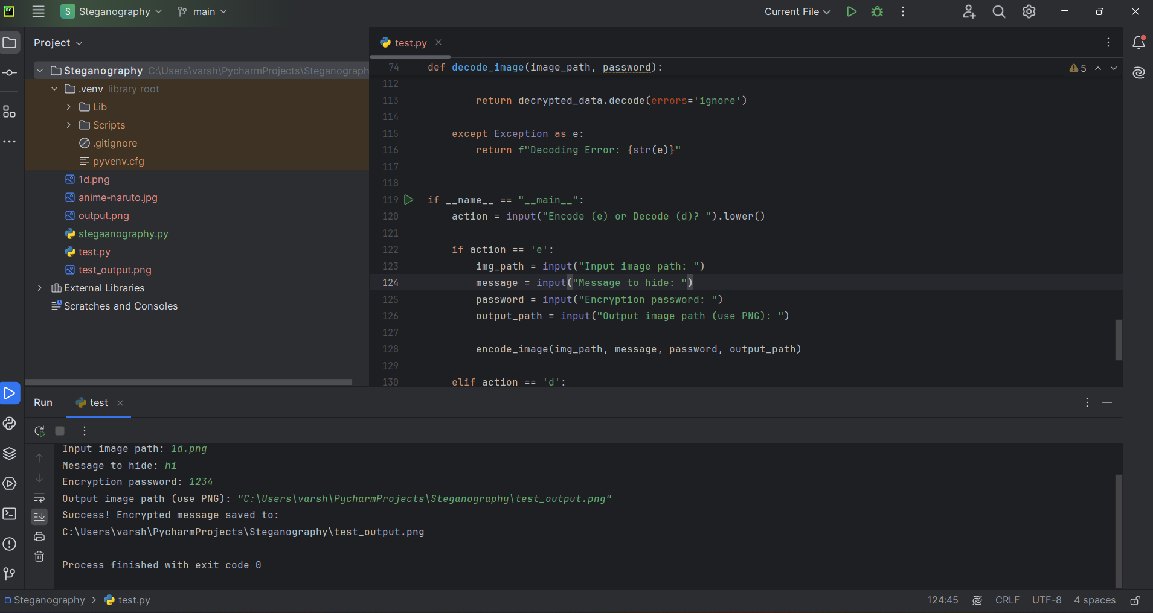
Results
The project successfully encodes messages into images and decodes them when needed. Users can input an image, a message, and a password to create a new image with the hidden message. The decoding process retrieves the hidden message using the correct password. The implementation is robust, handling various edge cases such as incorrect passwords and message size limitations.
Fig1: encryption of message.

Slide 8
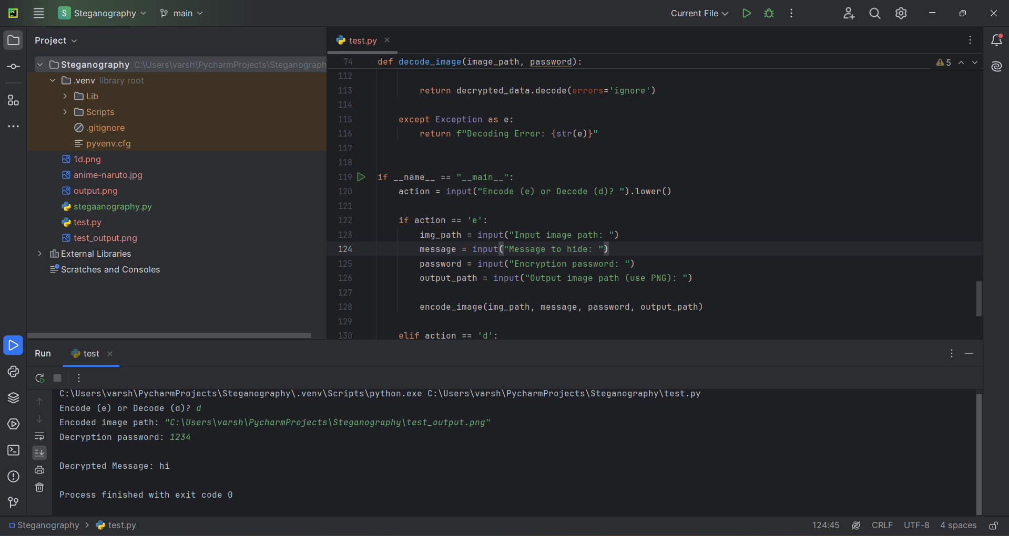
Results
Fig 2: message decryption

Slide 9
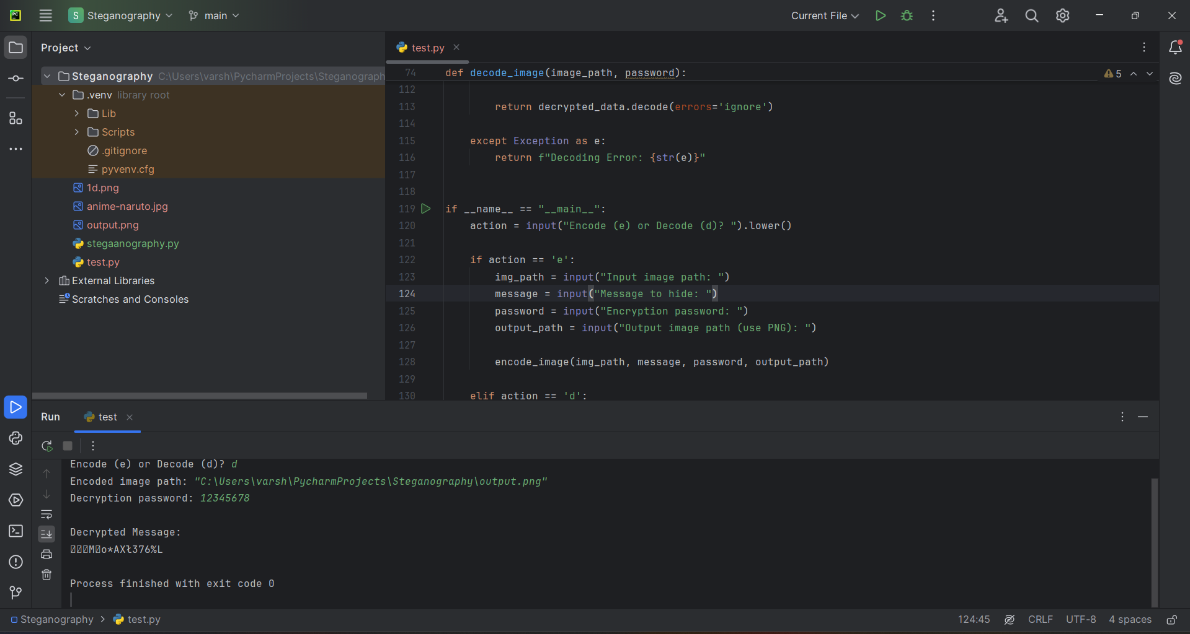
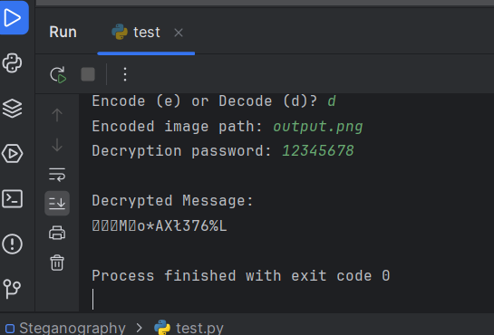
Results
Fig 4: decryption error
Fig 3: decryption error

Slide 10
Conclusion
This project demonstrates a practical application of steganography and encryption techniques to enhance data privacy. By allowing users to hide messages within images, it provides a discreet method of communication that can be beneficial in various scenarios. The combination of image processing and cryptography showcases the versatility of Python in solving real-world problems.
Overall, this project highlights the importance of data security in today's digital landscape. As we continue to navigate an increasingly interconnected world, solutions like this will play a vital role in protecting sensitive information and maintaining privacy in communication.

Slide 11
GitHub Link
Github link: https://github.com/varshinitatikonda/AICTE_cybersecurity.git

Slide 12
Future scope(optional)
User Interface: Develop a graphical user interface (GUI) to make the application more user-friendly.
Support for Multiple Formats: Extend support to other image formats (e.g., JPEG, BMP).
Advanced Encryption: Implement more advanced encryption algorithms for enhanced security.
Batch Processing: Allow users to encode/decode multiple images at once.

Slide 13
THANK YOU

